Slide 1



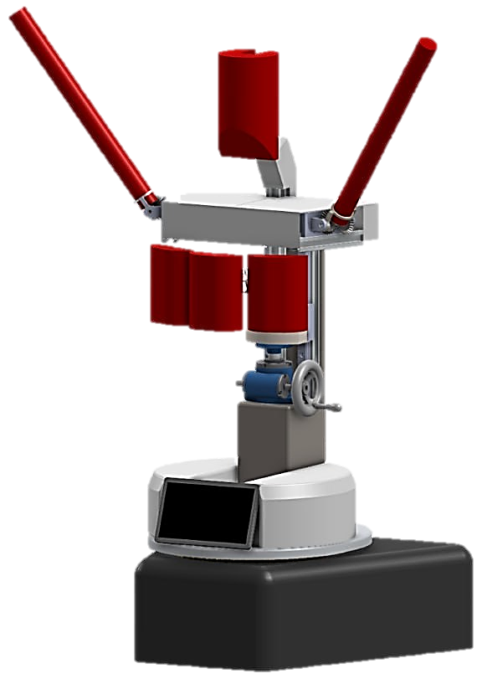
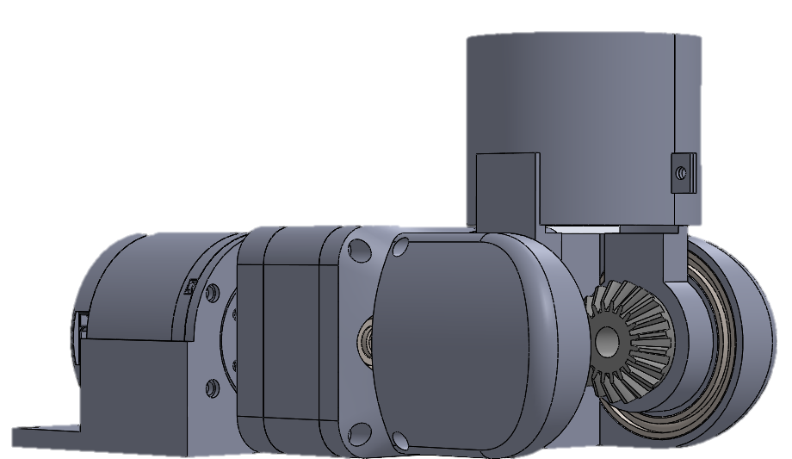




BoxBunny:
An Intelligent Boxing Trainer
DESIGN STATEMENT
Muhammad Zakir Haziq | Engineering Science Programme
Ng Jun Hao, Elgin | Engineering Science Programme
Sim Yu Jeanette | Engineering Science Programme
Muthukumaran Yogeeswaran | Engineering Science Programme
"How might we design an intelligent boxing training system that can dynamically & safely strike users while assisting coaches in guiding, monitoring, & sustaining boxer development both during & beyond training sessions.”
Contact Points
Polyethylene Foam punching contact points so boxers can punch & get punched without injury
Height Adjustment
Arm Actuation
Height-adjustable to accommodate boxers of varying heights
2 Degree-of-Freedom arm-mount that replicates training with boxing sticks used in training
PROBLEM
Footwork Mechanism
Rotating base to pivot along a single axis for enhanced footwork training
Robot Intelligence
12/20
of boxers struggle to stay consistent when progress feels slow or unclear
AI Brain with capabilities of LLM Coaching and Computer Vision to increase adaptability and make trainings insightful
KEY FEATURES
44%
of boxers face unreliable or unsuitable sparring partners
Sparring Partner: Reads and adaptively reacts to your attacks and defense!
Punch Combinations: Master your way up to 50 combinations even up from beginner level!
36%
of boxers fear high risk of injury during training
Performance: Test your power, stamina & reaction time with BoxBunny!
Engineering Design and Innovation Centre
Block E2A #04-05
5 Engineering Drive 2
Singapore 117579
Website:
https://cde.nus.edu.sg/edic/
NUS Innovation & Design Programme
nusidp
Email:
idp-query@nus.edu.sg
nusidp
NUS iDP
Innovation & Design Programme

Slide 3
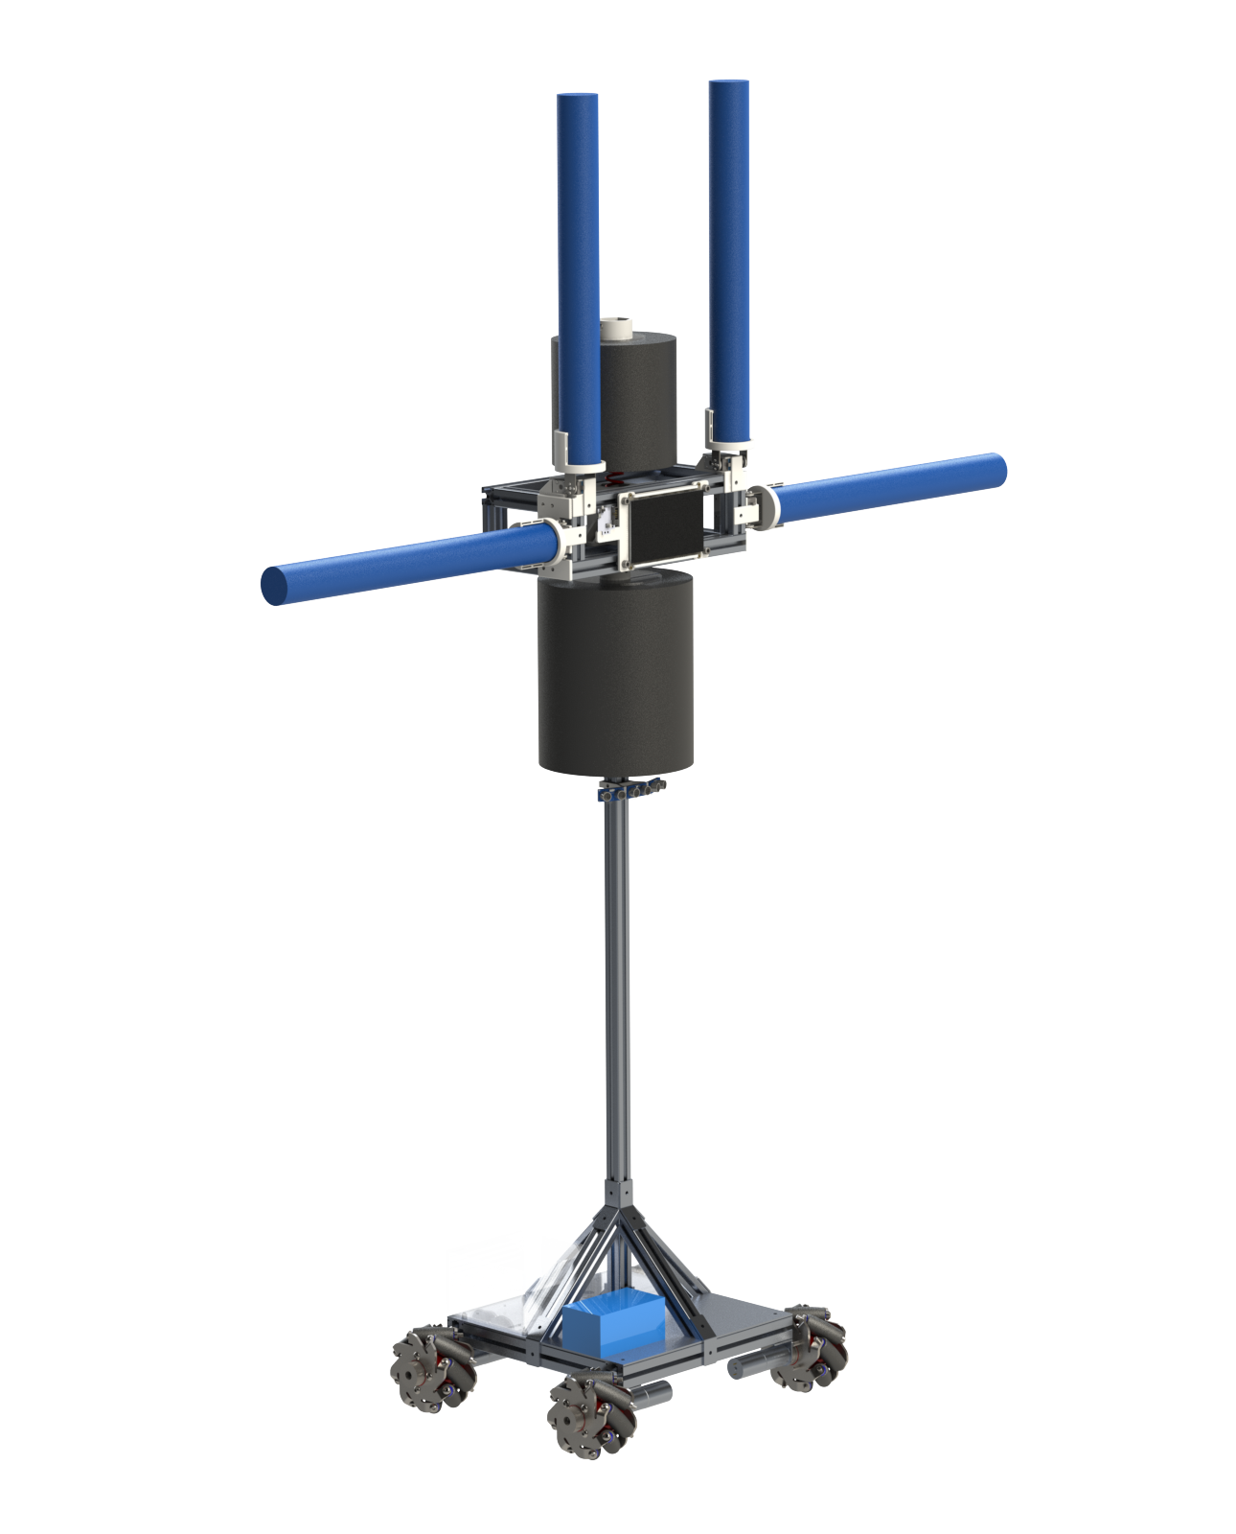

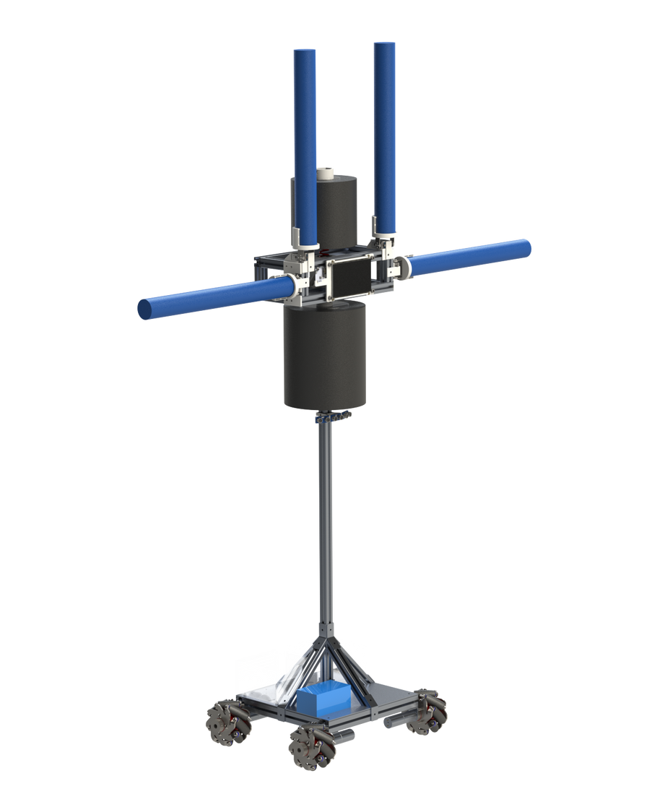

CONTEXT
BoxBUNNY: for boxers-in-development!
Ramie Lim Rui Min | Mechanical Engineering
Muhammad Zakir Haziq | Engineering Science
Sim Yu Jeanette | Engineering Science
Mageshkumar Kirubasankar | Mechanical Engineering
COVID-19
Processor
IMMERSIVE AND ENRICHING
AI-driven algorithms to spar with you in real time
LIMITED ACCESS TO TRAINING OPTIONS
PROGRESSIVE AND PERSONALISED
RELIANCE ON HOME-BASED SOLUTIONS
EASILY ACCESIBLE!
Camera
Detects your punches and reacts accordingly
NEED FOR FLEXIBLE, INNOVATIVE SOLUTIONS FOR BOXING TRAINING
Touchscreen
Full control over training modes and combos
Soft Contact Points
Reduces injury risk to users
Ultrasonic Sensors
CURRENT SOLUTIONS?
Tracks your movements and moves to follow you
TECHNICAL SPECIFICATIONS:
ASPECT
BOXBUNNY
Mecanum Wheels
Display
7" IPS (1024x600)
Capacitive Touch
BOXING CLASSES DON’T ACCOMMODATE TO VARYING SKILL LEVELS
Enhanced maneuverability ideal for dynamic environments
Battery Life
5 hrs
Weight
35 kg
KEY FEATURES
Size
0.4m (L) x 0.4m (W)
x 1.75m (H)
TRAINING WITH ANOTHER PERSON IMPOSES INJURY RISKS
Training Area Size
4 sqm
COMBO MODE
Personalised training for your punching combinations
Camera Tracking Speed
60 fps (16.7 ms)
Holding Torque of Arms
3.4 Nm
PERSONAL TRAINERS ARE LIMITED AND EXPENSIVE
SPAR MODE
Safe & Intelligent sparring partner to test your reflexes + sparring skills
Speed of Arms
0.11 sec/60° (no load)
0.13 sec/60° (full load)
Speed of Wheels
1.46 m/s

Slide 4
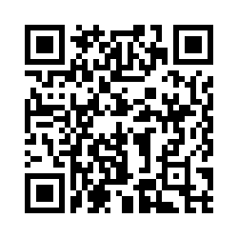
Insert your project title here.
Limit to at most two lines.
Student name 1 | Discipline 1
Student name 2 | Discipline 2
Student name 3 | Discipline 3
Student name 4 | Discipline 4
Student name 5 | Discipline 5
Suggested key points:
Summarise the problem of interest and the key features/aspects of your solution.
The highlighted features/aspects should clearly address the issues mentioned in the problem above.
You may insert few pictures/diagrams/charts that best represent the outcome of your project.
Requirements:
Minimum font size must be 28 pt.
Images must not be blur or pixelated when zooming in at 100%.
Delete this textbox after you insert your content.
DO NOT ALTER THE TOP AND BOTTOM BANNERS – YOUR CONTENT MUST BE PLACED ENTIRELY WITHIN THIS SPACE ONLY.
Engineering Design and Innovation Centre
Block E2A #04-05
5 Engineering Drive 2
Singapore 117579
Website:
https://cde.nus.edu.sg/edic/
NUS Innovation & Design Programme
nusidp
Scan here
to vote!
Email:
idp-query@nus.edu.sg
nusidp
NUS iDP
Innovation & Design Programme

